Slide 1
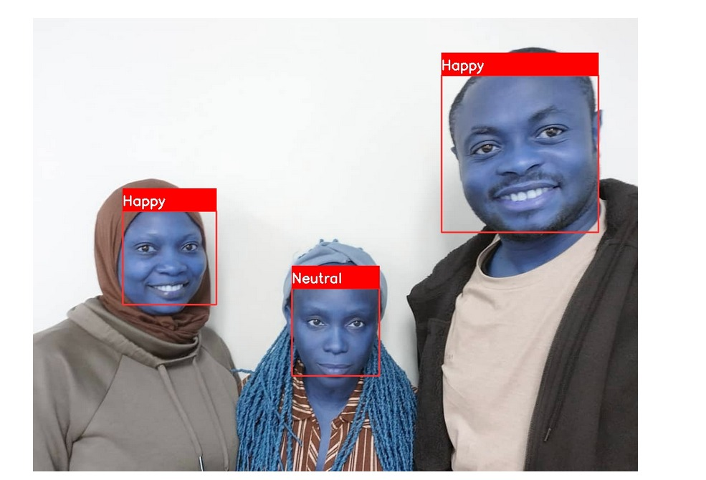
FACIAL EXPRESSIONS RECOGNITION
AML3104LAMBTON COLLEGE PROJECT
LECTURED BY:
ISHANT GUPTA

Slide 2
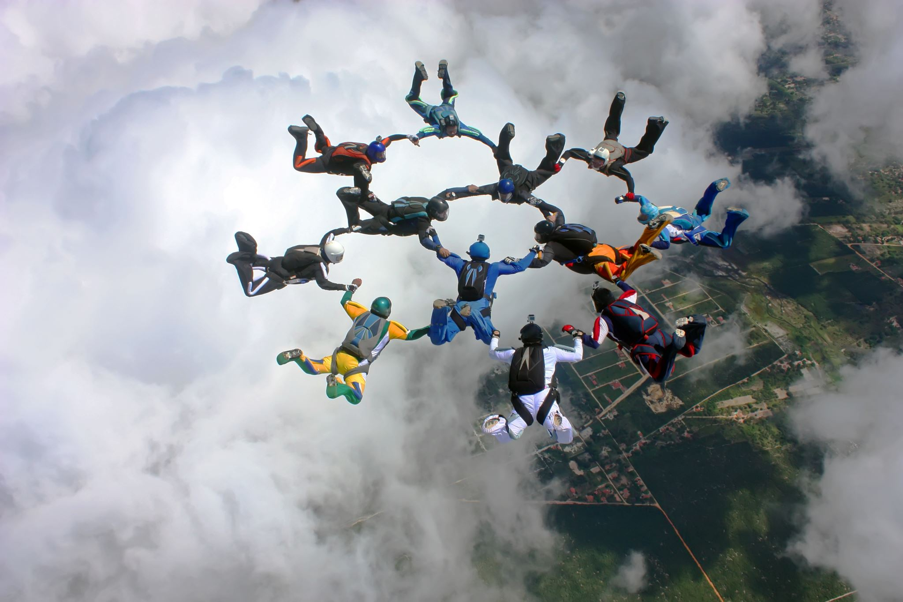
GROUP MEMBERS
CHIBUIKE OKOROAMA C0892150
JUMOKE KADIJAT YEKEEN C0900481
MODUPEOLA OYATOKUN C0895705
TEAM MEMBERS | ROLES
MODUPEOLA OYATOKUN | REPORTING AND DOCUMENTATION
JUMOKE KADIJAT YEKEEN | MODEL BUILDING
CHIBUIKE OKOROAMA | MODEL EVALUATION

Slide 3

AGENDA
PROJECT SCOPE | METHODOLOG | DEPLOYMENT | CONLCUSION |RECOMMENDATION

Slide 4
PROJECT SCOPE
The project data was obtained from Kaggle and consists of 48x48 pixel grayscale images of faces.
The faces have been automatically registered so that the face is more or less centred and occupies about the same amount of space in each image.
The task is to categorize each face based on the emotion shown in the facial expression into one of seven categories (0=Angry, 1=Disgust, 2=Fear, 3=Happy, 4=Sad, 5=Surprise, 6=Neutral).
The training set consists of 28,709 examples and the public test set consists of 3,589 examples.
Aim is to predict facial expression of random people
Where it can be used: Education, Healthcare, E-learning platforms, Customer services.

Slide 5
METHOLOGY
Important Libraries: Pandas, Seaborn, Tensorflow, Sklearn, Keras, os, cv2, joblib.
IDE: VSCode, Environment (venv), requirement, Experiment, Predict, app.py.
Load dataset
Data preprocessing
Data visualization
Model
Prediction

Slide 6
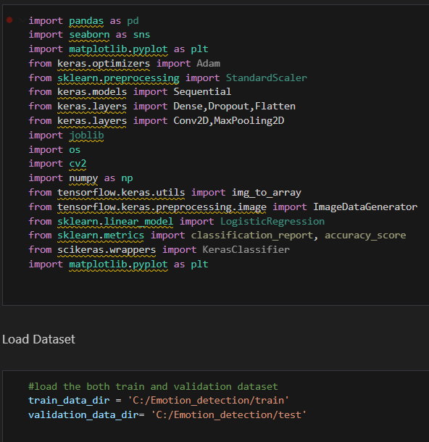
METHODOLOGY
IMPORT LIBRARIES & LOAD DATASET

Slide 7
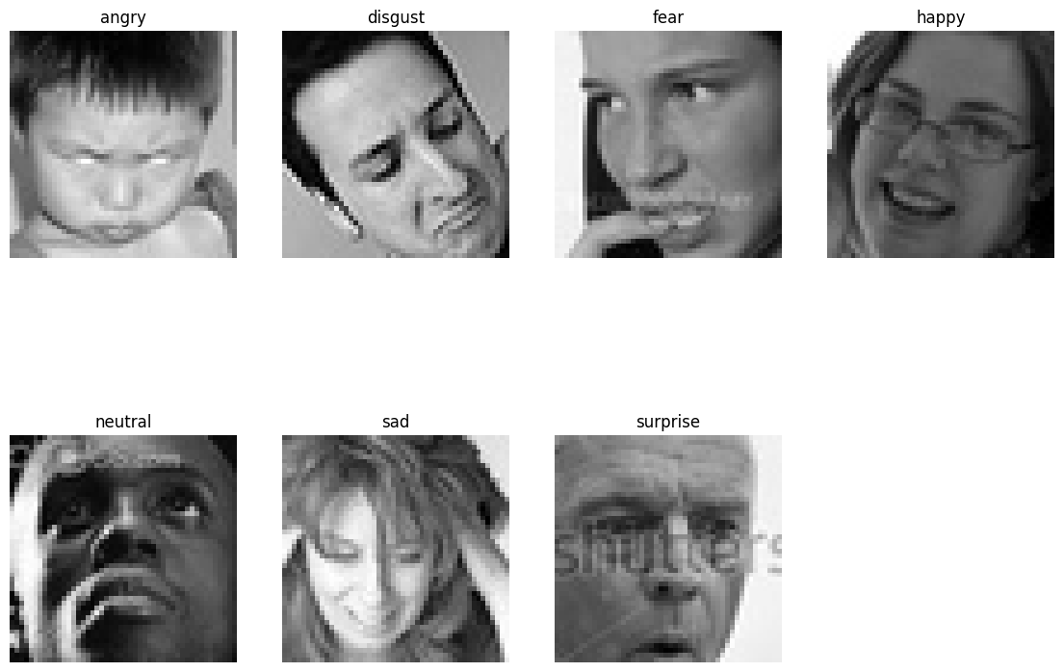
METHODOLOGY
data
Dataset categories

Slide 8
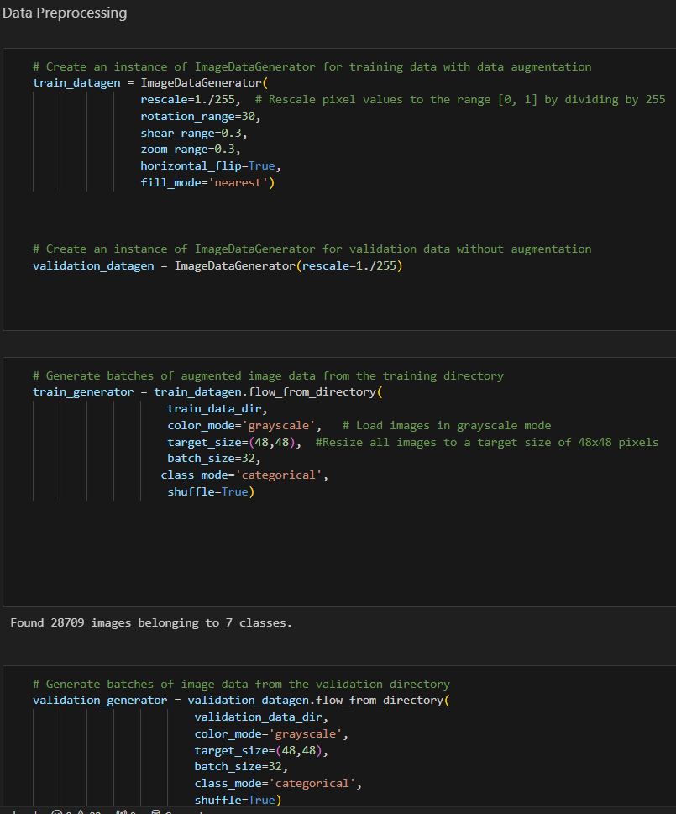
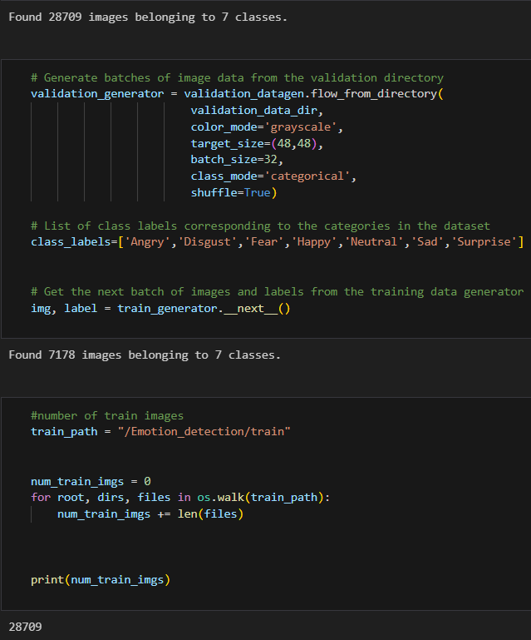
METHODOLOGY
Data Preprocessing
Preprocessing
Data augmentation
Image rescaling
Rotation
Zooming
Flipping
Feature engineering
Label encoding

Slide 9
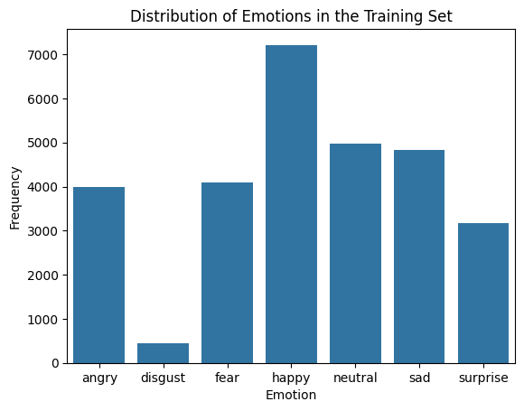
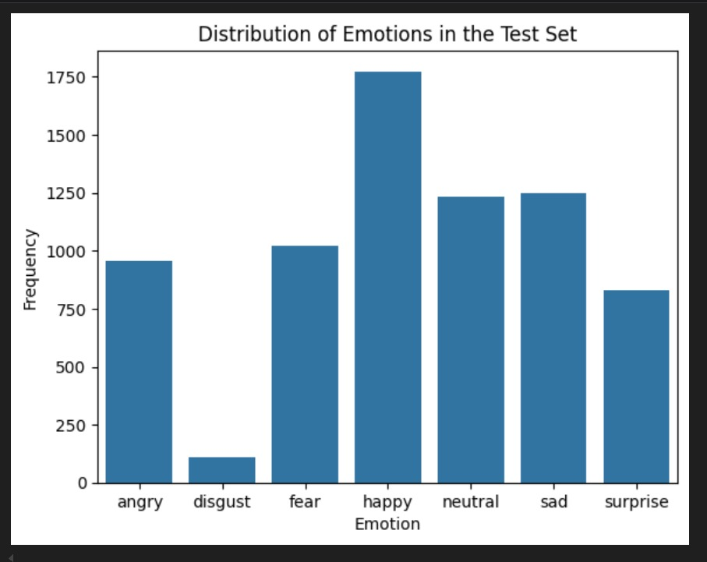
METHODOLOGY
Visualization

Slide 10
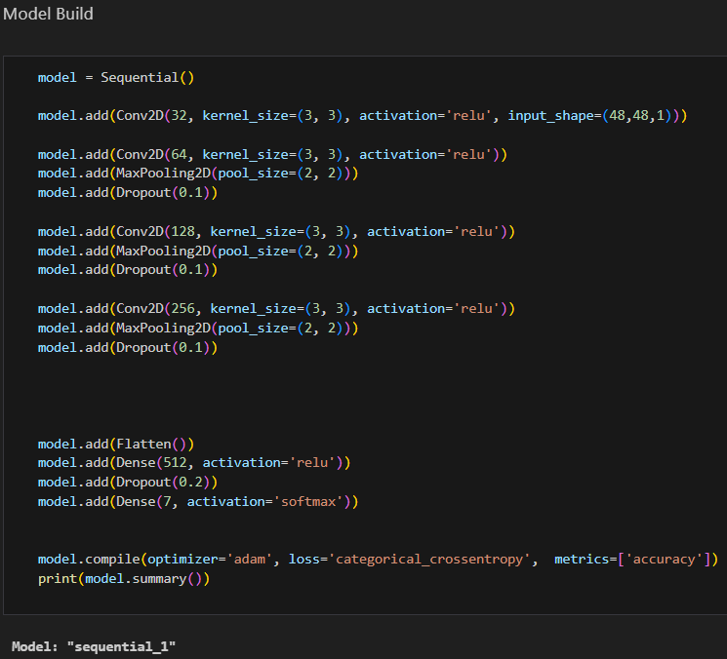
METHODOLOGY
Model BUILDING
The model is a Sequential CNN designed for grayscale images (48x48x1). It includes four Conv2D layers with increasing filters (32, 64, 128, 256), each using 3x3 kernels and ReLU activation, followed by MaxPooling2D and Dropout (0.1) for regularization. A Flatten layer transitions to a Dense layer with 512 units (ReLU) and a final Dense layer with 7 units (softmax) for classifying 7 emotions. The model is compiled with the Adam optimizer, categorical crossentropy loss, and accuracy as the evaluation metric.

Slide 11
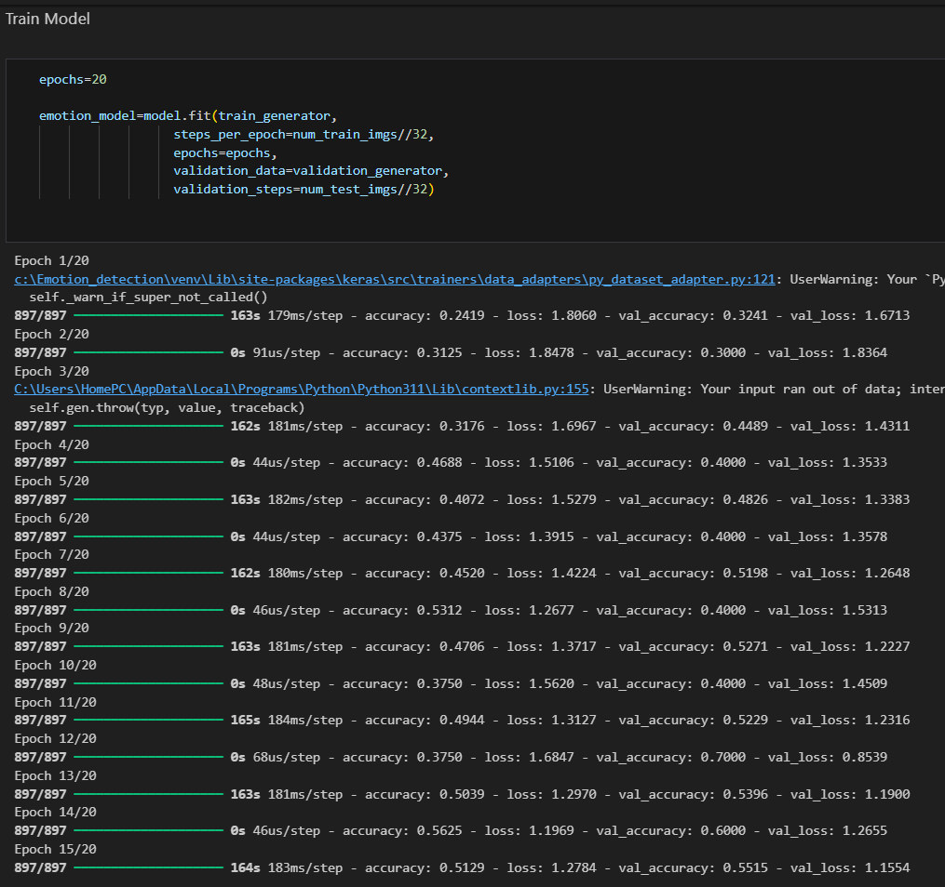
METHODOLOGY
Model BUILDING
The model is trained for 20 epochs, showing gradual improvement in accuracy and reduction in loss. By epoch 14, training accuracy reaches ~0.50, with validation accuracy peaking at ~0.70 and the validation loss decreasing to ~0.85, indicating the model is learning and generalizing better.

Slide 12
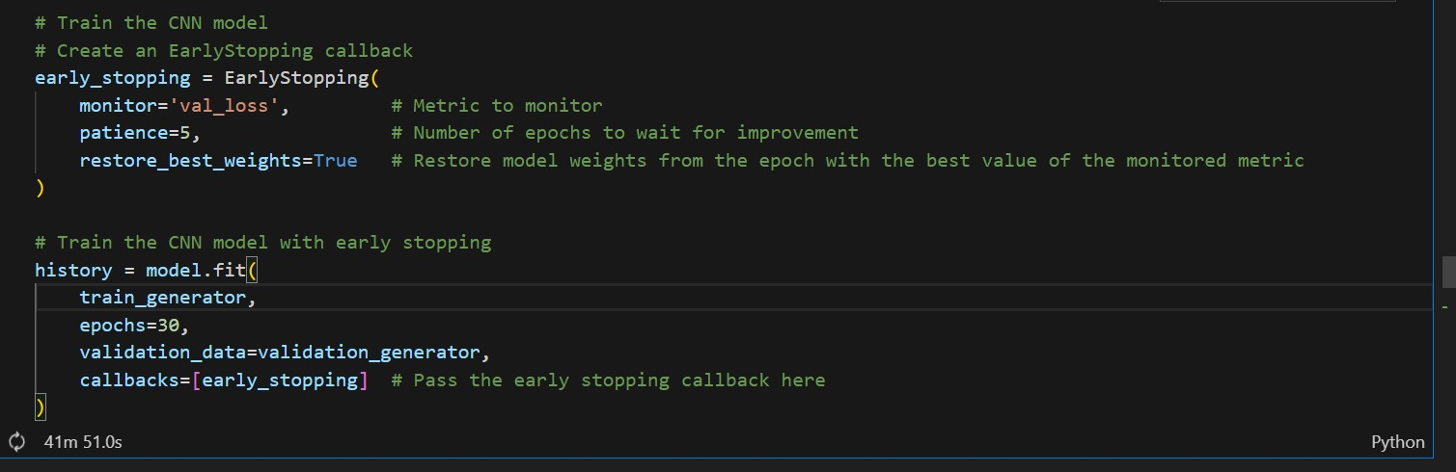
METHODOLOGY
model TRAINING
Adding EarlyStopping to the model

Slide 13
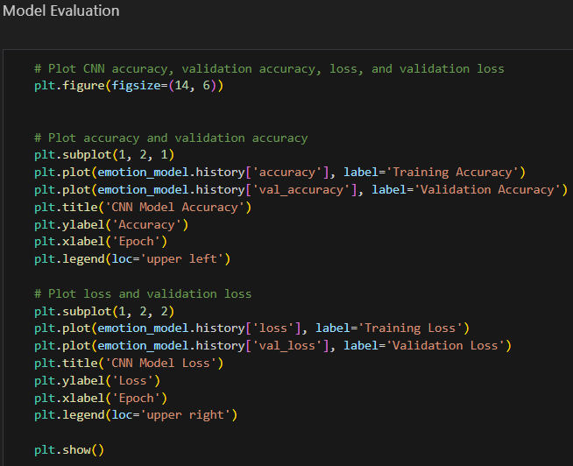
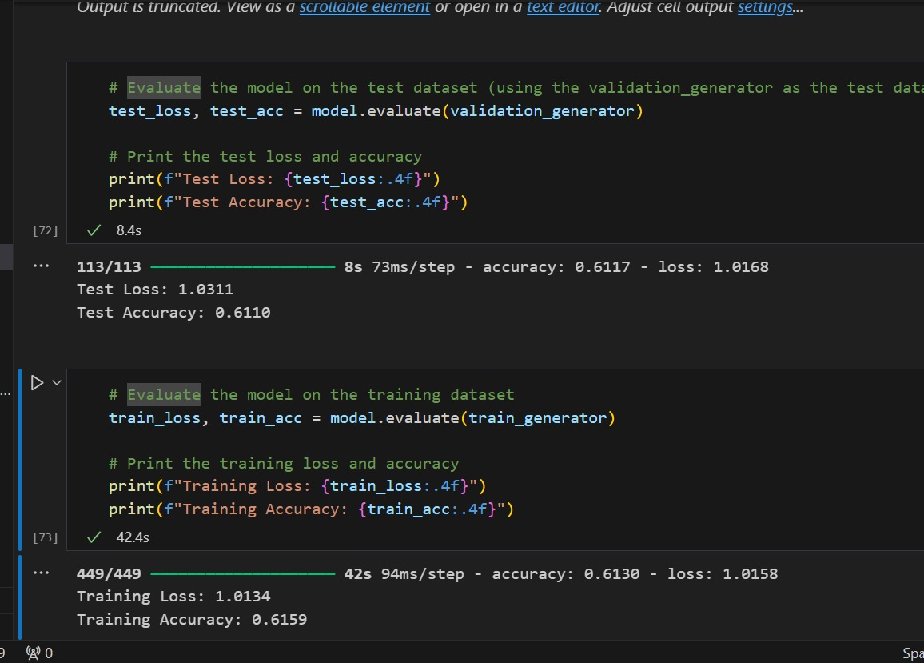
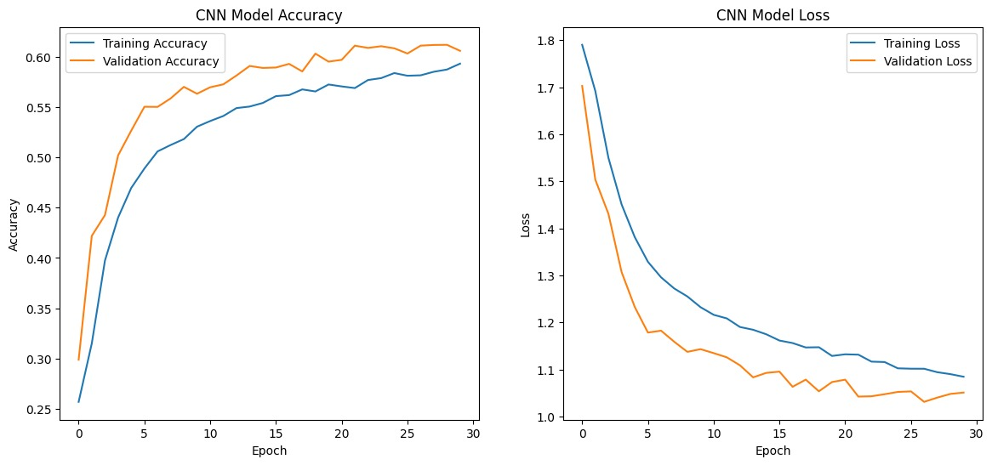
METHODOLOGY
model EVALUATION

Slide 14
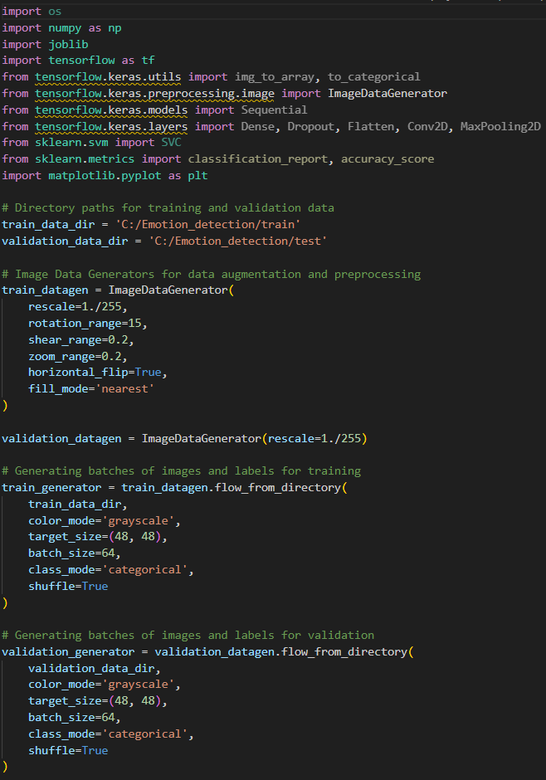
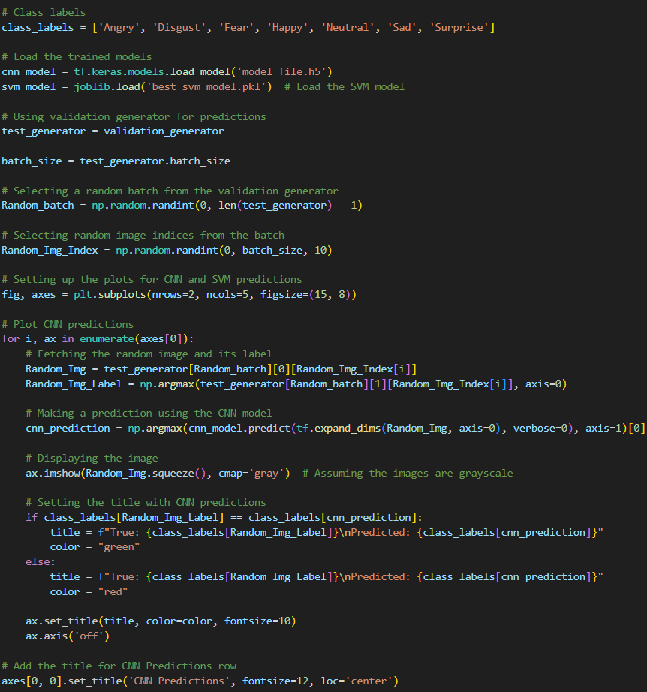
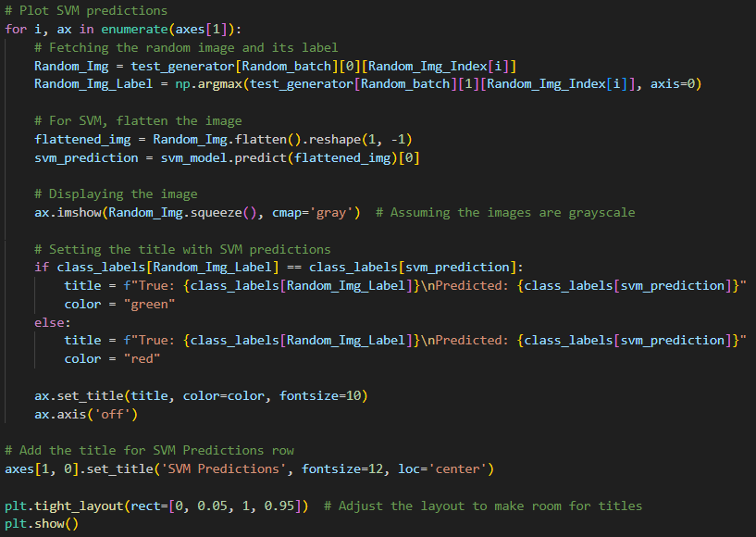
PREDICTION
LOCAL INPUT

Slide 15
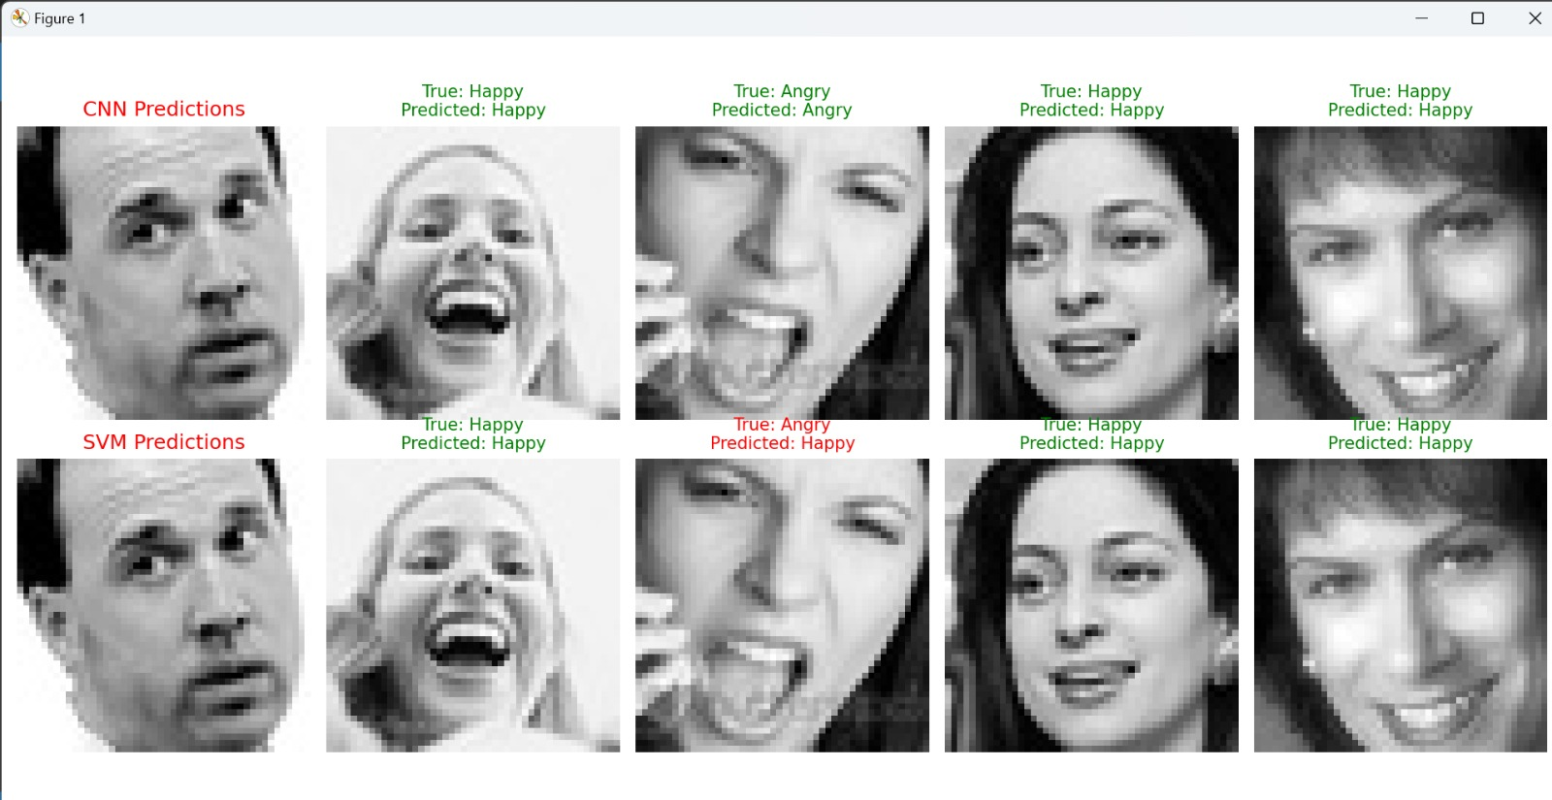
PREDICTION
LOCAL INPUT

Slide 16
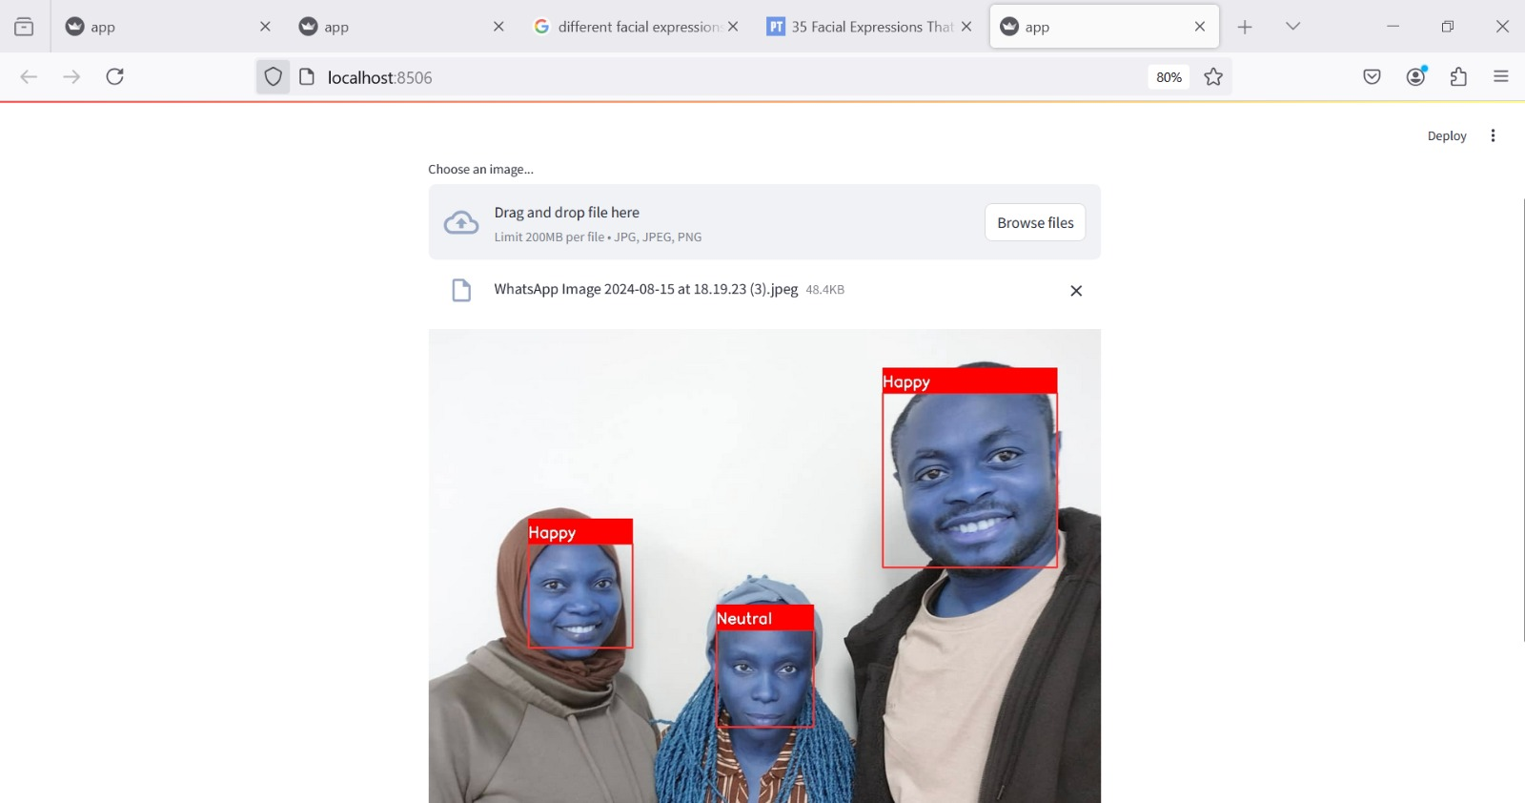
DEPLOYMENT
LOCAL HOST

Slide 17
CONCLUSION
FACIAL EXPRESSIONS RECOGNITION
The Convolutional Neural Network (CNN) demonstrated improved learning over time with a test accuracy of 61.10%. The model showed reasonable performance in classifying emotions from images. In contrast, the Support Vector Machine (SVM) model, though employing hyperparameter tuning, underperformed significantly, achieving only 32.81% accuracy. This indicates that the CNN is better suited for this image classification task, likely due to its ability to capture spatial hierarchies and patterns in image data, while the SVM struggled with the complexity of the visual features.

